Slide 1

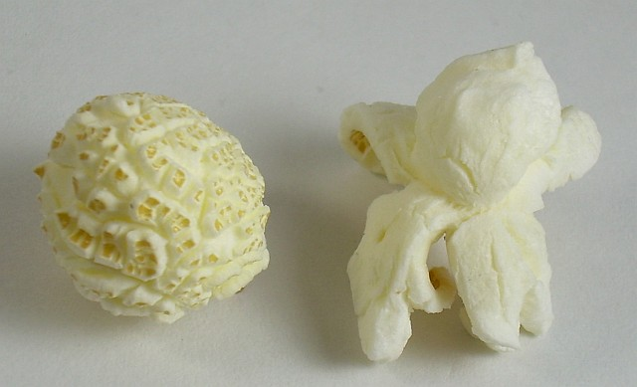
Star Debris Apocalypse
Description, Classes, Interfaces, Hierarchy, Specifics
The Yogi Bear Team
Telerik Software Academy
academy.telerik.com

Slide 2
Contents
Overview
The GameObject class
The BorderBlock class
The IRenderer interface and ConsoleRenderer
The MovingObject, Ship, Rock, Bullet classes
The IUserInterface and KeyboardInterface
The CollisionDispather
The Engine class

Slide 3
Star Debris Apocalypse
Overview
Notes:
(c) 2006 National Academy for Software Development - http://academy.devbg.org*
3##

Slide 4


Slide 5
SDA API
Provides an API for a matrix-based game of SDA
Important classes
GameObject – base class for objects in the game
IRenderer – interface for rendering objects
IUserInterface – interface for handling input
Engine – runs the game, checks for input and renders the scene
CollisionDispatcher – notifies objects of their collisions
5

Slide 6
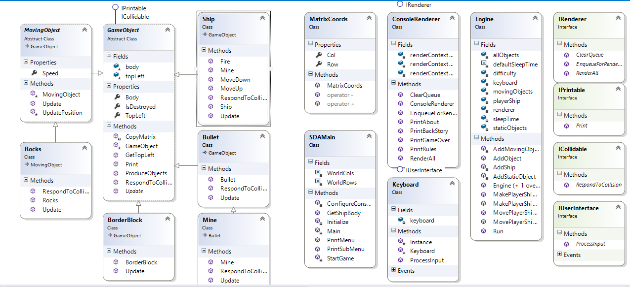
SDA API
Class Diagram
Notes:
(c) 2006 National Academy for Software Development - http://academy.devbg.org*
6##

Slide 7
The GameObject class
Notes:
(c) 2006 National Academy for Software Development - http://academy.devbg.org*
7##

Slide 8
The GameObject class
Base class for all objects in the game world
Abstract class
Implements the IPrintable interface
Provides a Print method – returns a char matrix for visualization
Used by the IRenderer
8

Slide 9
The GameObject class (2)
Implements the IObjectProducer interface
Enables objects to produce other objects
Implements the ICollidable interface
Enables objects to participate and respond to collisions
The Update method
Abstract method
Inheriting classes implement their behavior there
9

Slide 10
The GameObject class (3)
Other fields
TopLeft – top left coordinates of the object in the world
Represented by instance of MatrixCoords
body – defines the body of the object as a char matrix
IsDestroyed – property indicating if the object should be removed from the world
10

Slide 11
The BorderBlock class
Notes:
(c) 2006 National Academy for Software Development - http://academy.devbg.org*
11##

Slide 12
The BorderBlock class
Inherits the GameObject class
Describes a indestructible block
Has a constructor, which initializes the body and sets it on given position
It is used for stationary objects as the Earth and the field border, does not Update()
Does not Respond to Collision
12

Slide 13
The IRenderer Interface and ConsoleRenderer
Notes:
(c) 2006 National Academy for Software Development - http://academy.devbg.org*
13##

Slide 14
IRenderer & ConsoleRenderer
IRenderer – provides interface to methods for displaying IPrintable
EnqueueForRendering – adds a IPrintable objects to the rendering queue
RenderAll – flushes the rendering queue to the screen
ClearQueue – removes all objects from the rendering queue
Should be called after RenderAll
ConsoleRenderer – implements IRenderer for console display
14

Slide 15
The MovingObject, Ship, Rock and Bullet classes
Notes:
(c) 2006 National Academy for Software Development - http://academy.devbg.org*
15##

Slide 16
MovingObject & Rock
MovingObject – game object with a speed property
Speed is a vector but in this case it is constant, east-to-west oriented
Has overridden Update
Updates the TopLeft by adding Speed
Rock– inherits MovingObject
Overrides RespondToCollision to enable a Rock to be destroyed
16

Slide 17
Ship and Bullet
Inherit GameObject directly
Ship has methods for moving up and down and firing
The Fire() method produces Bullets
Bullets, like Rocks travel only in one direction
Ship, Bullet and BorderBlock on impact with a MovingObject (Rock) trigger some event
This is handled by the CollisionDispatcher

Slide 18
Collision Dispatcher Class

Slide 19
Collision Dispatcher
Checks whether a MovingObject is overlapping another GameObject
Throws GameOver Exception??? - no
Makes GameObject Respond to Collision
Counts number of collisions and lives left

Slide 20
The IUserInterface and Keyboard
Notes:
(c) 2006 National Academy for Software Development - http://academy.devbg.org*
20##

Slide 21
IUserInterface & KeyboardInterface
IUserInterface – provides processing of user input
ProcessInput method – checks for user input and signals the appropriate events
OnActionPressed, OnUpPressed, OnDownPressed, OnMinePressed
Events for action (e.g. "shoot" ), move up and move
Keyboard – implements IUserInterface for keyboard interaction
21

Slide 22
The Engine Class
Notes:
(c) 2006 National Academy for Software Development - http://academy.devbg.org*
22##

Slide 23
The Engine Class
Manages game objects, user interface and visualization; all public methods are virtual
Uses a IUserInterface
Uses a IRenderer
Has several GameObject lists
allObjects
movingObjects
staticObjects
Has a separate Ship object list
For control over the player ship
Has methods for controlling the Ship
23

Slide 24
The Engine Class (2)
Important members
AddObject method – adds a GameObject
Run method – starts a "game loop":
Draws the scene
Checks for input
Clears the rendering queue
Calls Update for all objects
Calls ProduceObjects for all objects and collects
Removes all destroyed objects
Adds all produced objects
Catches an Exception which breaks the loop - no
24

Slide 25
SDA
Questions?
http://academy.telerik.com

